Slide 1
Machine Translation Project
National Institute of Technology Hamirpur
Department of Computer Science and Engineering
M.Tech (Artificial Intelligence)
Mentor: Dr Robin Bhadoria
Course Code:
Presenter: Udit Sehra
Reg No: 23MCS107

Slide 2
RNN Architecture for English-French Machine Translation

Slide 3
Abstract
A Comparative Study of RNN Architectures for English-French Machine Translation
This project explores the application of sequence-to-sequence (seq2seq) models with recurrent neural networks (RNNs) for machine translation between English and French. The focus lies on utilizing Long Short-Term Memory (LSTM) units within the RNN architecture to capture long-term dependencies and context within sentences, leading to more accurate and fluent translations.
The project aims to contribute to the advancement of machine translation by demonstrating the effectiveness of LSTM-powered seq2seq models in bridging the linguistic gap between English and French. The findings will shed light on the capabilities of LSTMs in handling complex sentence structures and idiomatic expressions, ultimately paving the way for further research and development in this exciting field.

Slide 4
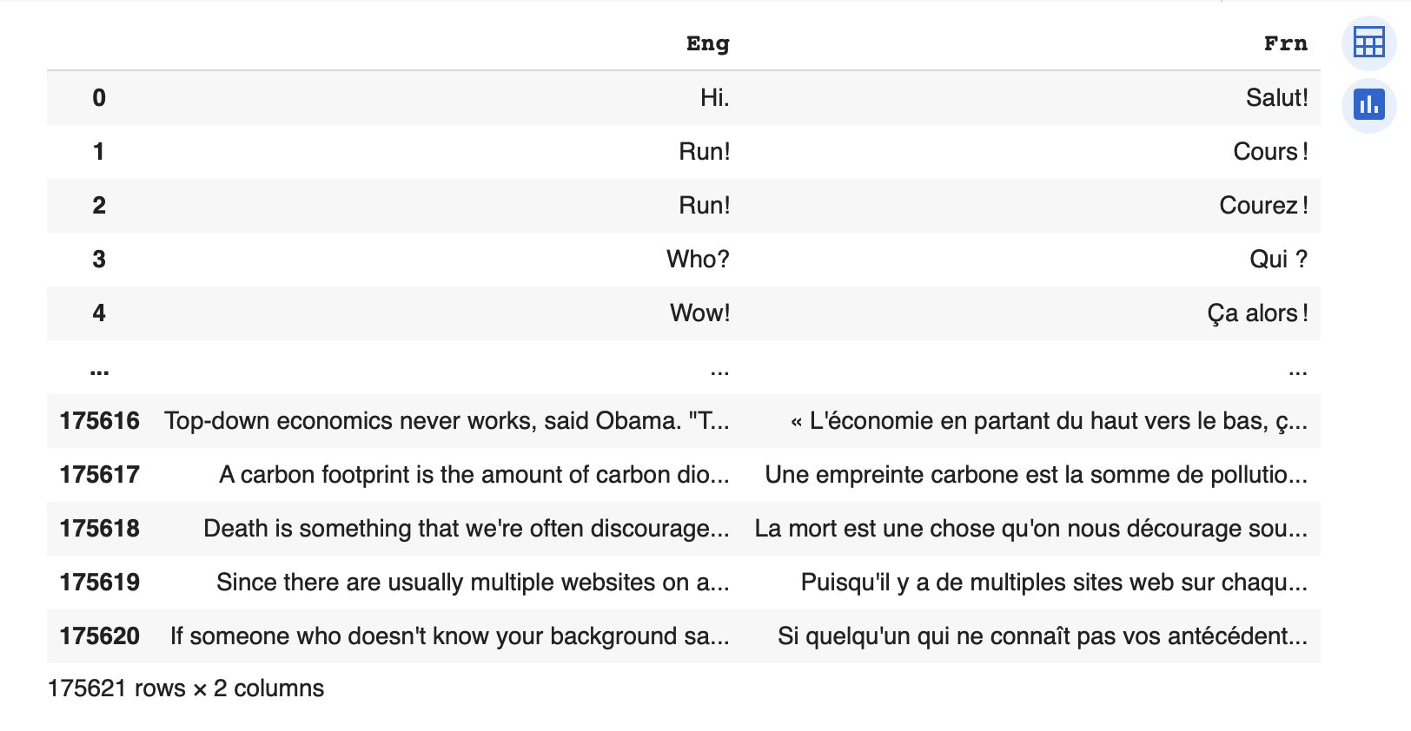
Dataset
Bilingual Parallel Corpus for English-French language
No of sentences - 1,75,621
#English Words = 1082098
#French Words = 1177832
Vocabulary Size:
English - 14,532
French - 30,661

Slide 5
Algorithm
Load Dataset
Preprocessing
Tokenization
Transformer
Encoder
Embedding
Decoder
Output

Slide 6
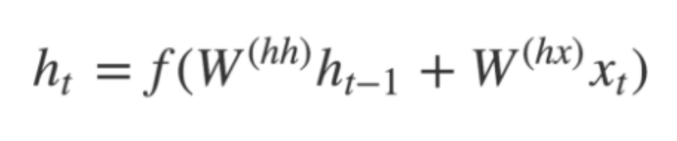
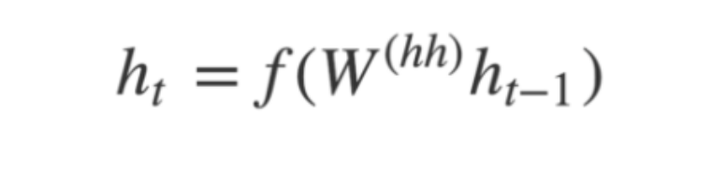
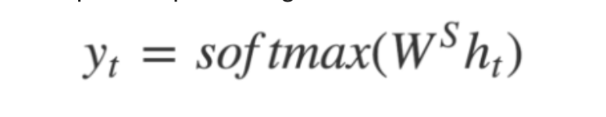
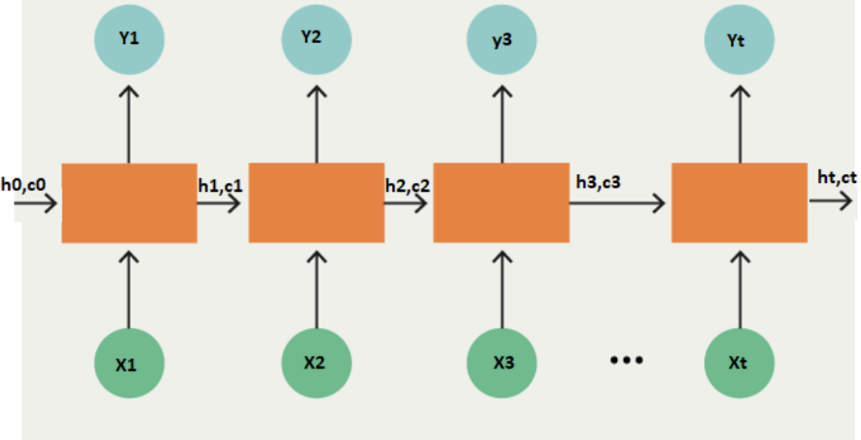
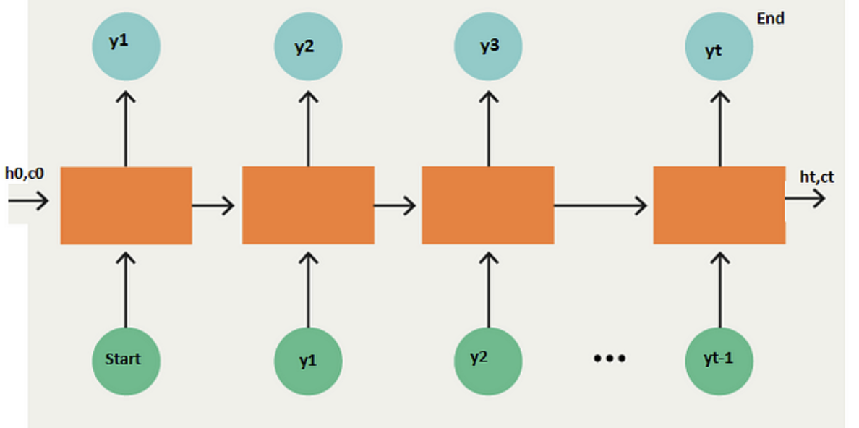
Architecture
W
W
W
W
Encoder
Decoder

Slide 7
Parameter Evaluation
Hyper Parameter Tuning
Epochs – 50
Batch-size – 128
Learning Rate – 0.01
#Hidden Layers – 10
Optimization Algorithm – Adams

Slide 8
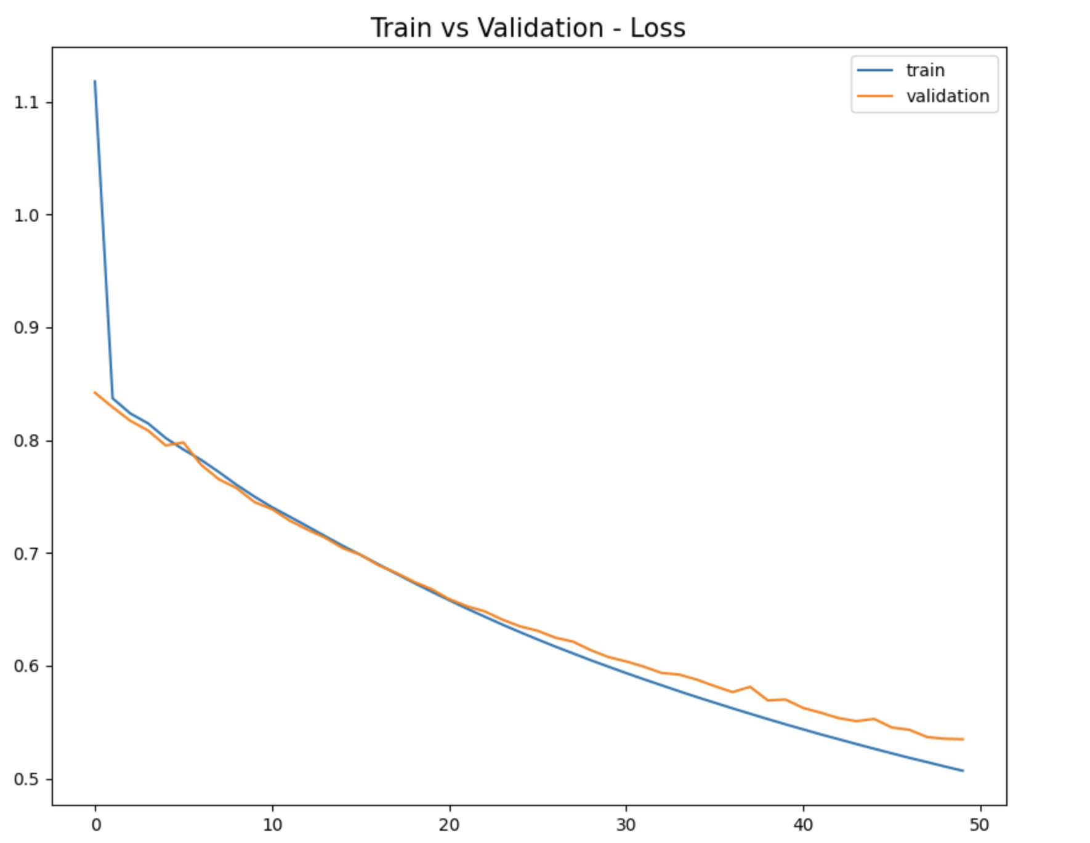
Experiments
Evaluation Metrics
BLEU Score : 33.03164318013809
Rogue-Score:
'rouge1’ : 0.5396825396825397
'rouge2’ : 0.15384615384615383
'rougeL’ : 0.4507936507936508
METEOR Score: 0.28083940608273206
Cross Entropy Loss : 0.5348

Slide 9
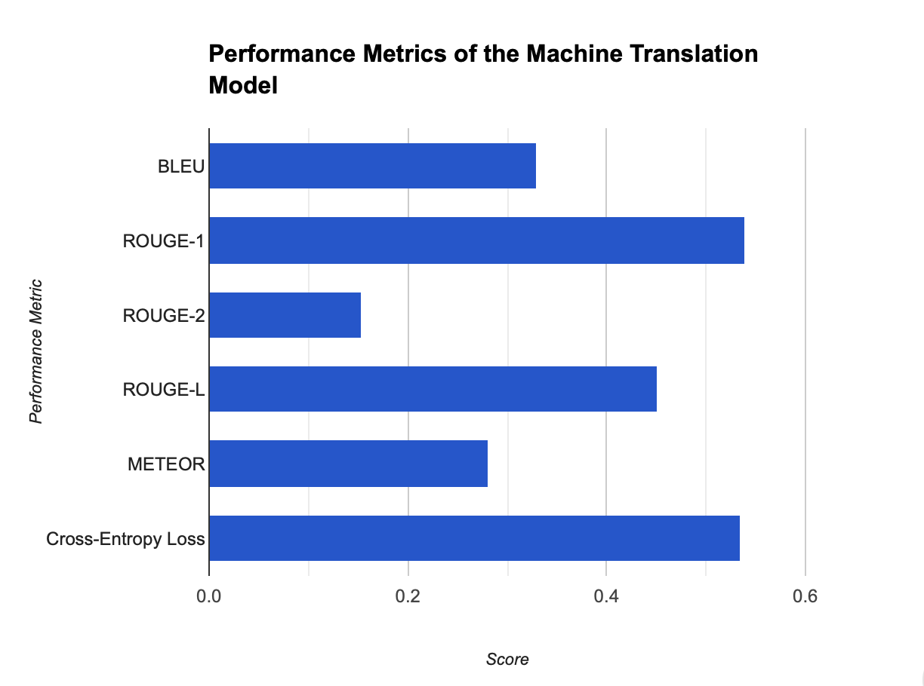
Result Analysis
BLEU stands for Bilingual Evaluation Understudy. It is a measure of how well a machine translation model preserves the meaning of the original text. A BLEU score of 0.3303 indicates that the machine translation model is able to produce translations that are fluent and accurate.
ROUGE stands for Recall-Oriented Understudy for Gisting Evaluation. It is a measure of how well a machine translation model preserves the content of the original text. A ROUGE-1 score of 0.5397 indicates that the machine translation model is able to preserve the content of the original text well.
ROUGE-2 is a more specific version of the ROUGE-1 metric that focuses on bigrams, or pairs of consecutive words. A ROUGE-2 score of 0.1538 indicates that the machine translation model is able to preserve the bigrams of the original text to some extent.
ROUGE-L is a variation of the ROUGE metric that takes into account the longest common subsequence of the machine translation output and the original text. A ROUGE-L score of 0.4508 indicates that the machine translation model is able to preserve the overall structure of the original text to some extent.
METEOR stands for Metric for Evaluation of Translation with Explicit Ordering. It is a measure of how well a machine translation model produces translations that are both semantically and syntactically correct. A METEOR score of 0.2808 indicates that the machine translation model is able to produce translations that are both semantically and syntactically correct to some extent.
Overall, the machine translation model that is evaluated in the image you sent is performing well. It is able to produce translations that are fluent, accurate, and preserve the meaning, content, and structure of the original text.

Slide 10
Conclusion
The model achieved a BLEU score of 0.3303, demonstrating its ability to produce fluent and accurate translations.
The model's performance in Rouge metrics, with a Rouge-1 score of 0.5397, Rouge-2 score of 0.1538, and Rouge-L score of 0.4508, further confirms its effectiveness in preserving the meaning and content of the original French text.
The METEOR score of 0.2808 further supports the model's overall translation quality, indicating its ability to produce translations that are both semantically and syntactically correct.
These results indicate that the machine translation model is a valuable tool for translating between French and English, capable of producing high-quality translations that are both accurate and fluent.

